Slide 1
U N C O V E R S K I N C A R E N I G E R I A L A U N C H
D A T A A N A L Y S I S : P R E S E N T E D B Y V I V I A N K I N G ' A S I A

Slide 2
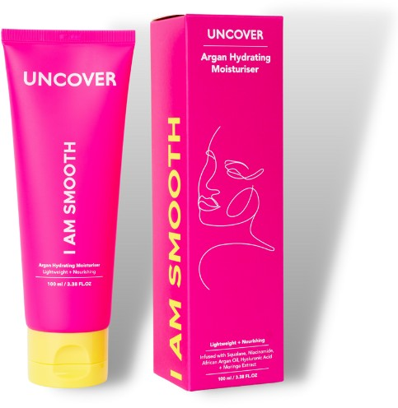
T A B L E O F C O N T E N T S
01
02
03
04
05
Problem Statement
Data Analysis Process
Exploratory Data Analysis
Conclusion
Recommendations

Slide 3
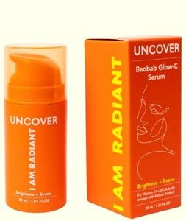
P R O B L E M S T A T E M E N T
Uncover Skincare wants to launch its skincare products in Nigeria in January 2023. The company has collected data through social media [Instagram and WhatsApp] from 1067 respondents.
The data has been cleaned, analyzed, and explored through different visualizations before conclusions and recommendations are made.
The information collected will inform product development, marketing and customer service.

Slide 4
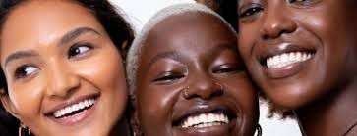
D A T A A N A L Y S I S P R O C E S S
Data was cleaned by addressing missing values in the dataset.
Data was explored through different visualizations based on the study's objectives and Uncover's main questions.
Questions
What are the market's main skincare concerns and pain points? What is the consumer profile in Nigeria for Uncover products?
What kind of marketing, what strategies and locations would be most effective?

Slide 5
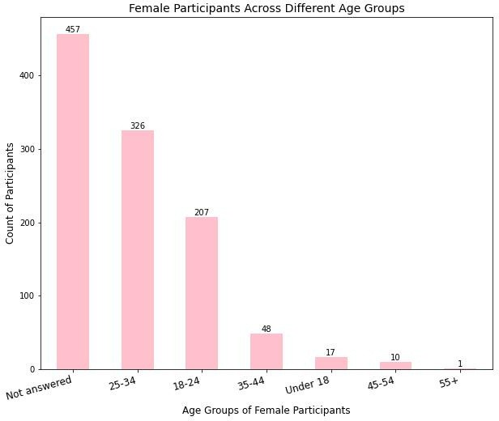
C U S T O M E R P R O F I L E
(42.9%)
The age group of 25-34 comprised the largest proportion of participants (326) followed by the 18- 24 age-group.
Might be because these are the largest Instagram and Whatsapp users or perhaps are the ones more interested in skincare in this market.
These two groups are potentially the age groups that Uncover can target with their products and market to.
55+ is the smallest group perhaps because they do not use social media platforms such as Instragram as much.
To encourage inclusivity Uncover can reach out to the older groups through other platforms.
(30.6%)
(19.4%)
(4.5%)
(1.6%)
(0.9%)

Slide 6
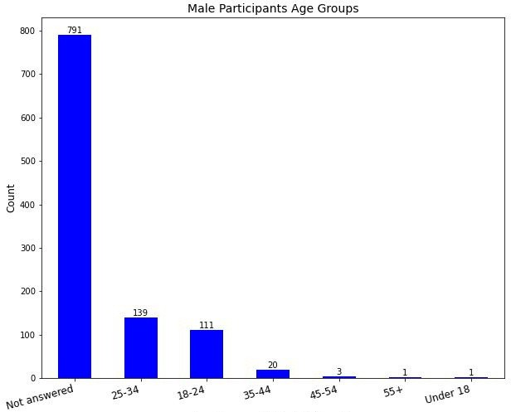
T H E M A L E C U S T O M E R
(74.2%)
(13.0%)
(10.4%)
(1.9%).
The majority of the participants were female which is indicative of the skincare market globally.
Similar to the female participants, the largest group of male participants was the 25-34 agegroup which perhaps reflects their social media presence compared to other age groups.

Slide 7
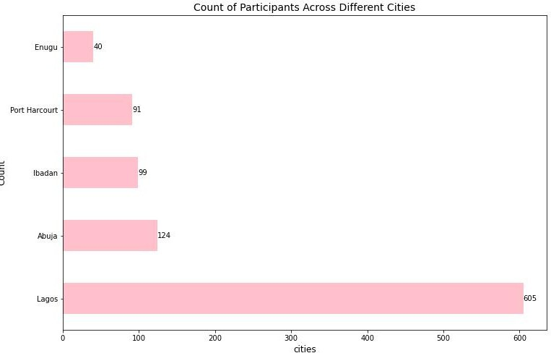
L O C A T I O N O F T H E C U S T O M E R S
(3.8%)
Lagos, Abuja, Ibadan, and Port Harcourt comprised the cities with the largest number of respondents
Uncover has the potential for focusing marketing and distribution across these top 5 urban cities.
(8.5%)
(9.3%)
(11.6%)
(56.8%)

Slide 8
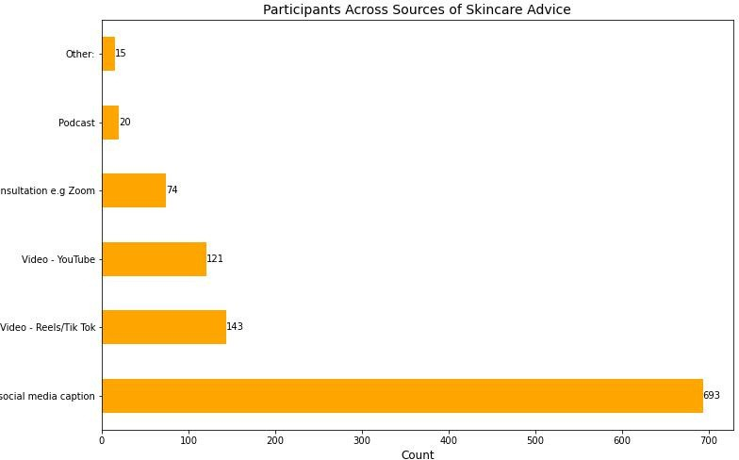
S O U R C E S O F S K I N C A R E I N F O R M A T I O N
1.4%
Participants would like to receive information on skincare through either blogs, social media posts, emails and secondly through video reels on either Instagram or TikTok.
1.9%
6.9%
11.4%
13.4%
65.0%

Slide 9
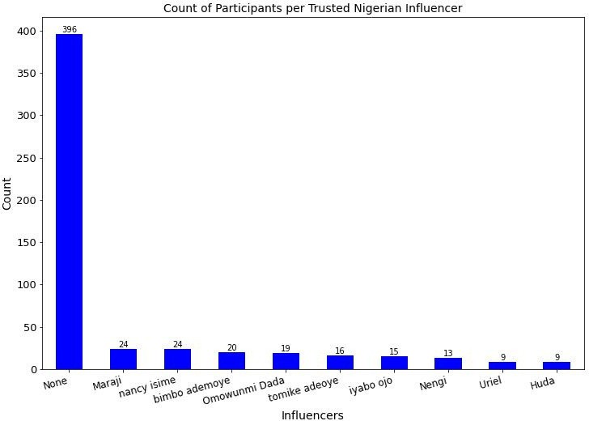
I N F L U E N C E R M A R K E T I N G
Most of the respondents are not attached to any influencer.
Gives Uncover the opportunity to partner up with influencers who align with their values and goals . Uncover should also consider partnering with Maraji (1.4million followers), Nancy Iseme (4.8million followers), Bimbo ademoye (2.3million followers) and Omowunmi Dada (324k followers).

Slide 10
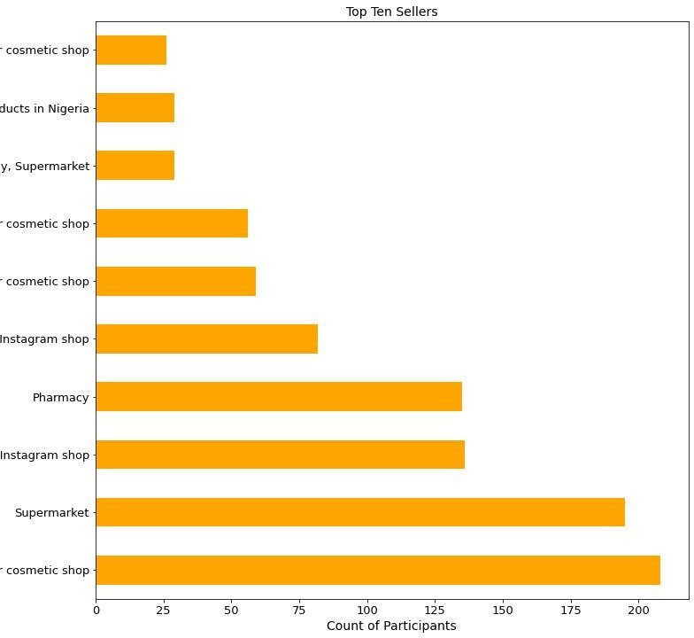
T O P S E L L E R S O F S K I N C A R E
Participants prefer to purchase their products from physical stores such as supermarkets or health and beauty shops compared to online shops.
In the online versus offline debate, the Nigerian market is still offline-centered.

Slide 11
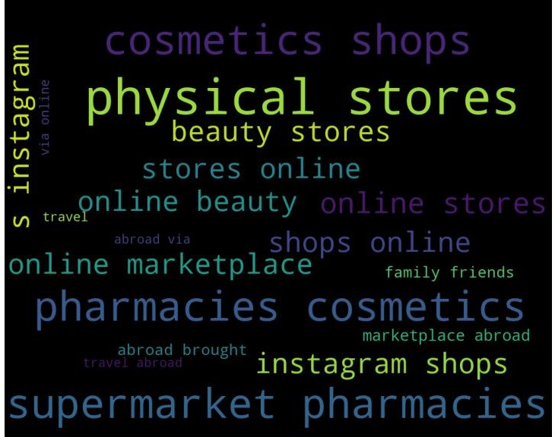
T O P S E L L E R S O F S K I N C A R E
There is the potential for Uncover choosing to distribute and sell their products in physical stores in Nigeria such as supermarkets, beauty stores and pharmacies mainly and online stores secondly as these are the biggest sources of skincare products.

Slide 12
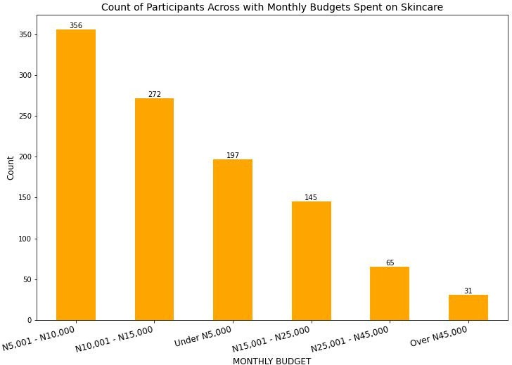
C O S T O F S K I N C A R E
(33.4%)
(25.5%)
Most participants are willing to spend between 5000 and 10000 Naira on skincare which is between 11 and 22 dollars.
The next group are will to spend upto 15,000 Naira which is equivalent to almost 33 dollars. This shows that the market is looking for affordable skincare.
To ensure that Uncover captures the market, they have to price their products between 11 and 33 dollars as over 55 dollars will lead to lower sales.
(18.5%)
(13.6%)
(6.1%)
(2.9%)

Slide 13
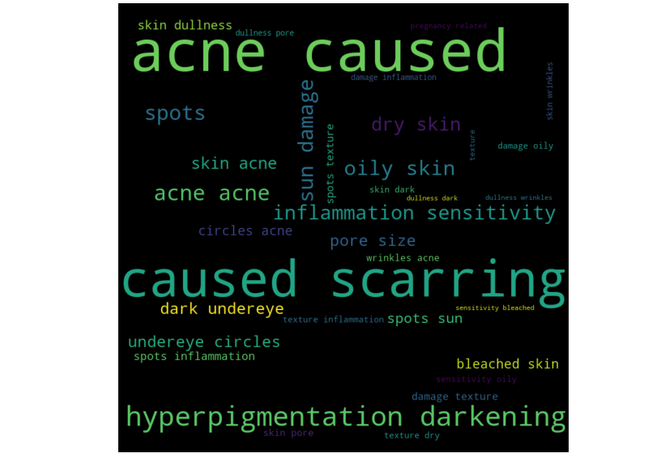
P R I M A R Y S K I N C A R E C O N C E R N S
Some of the primary skincare concerns for the participants are acne, scarring and spots, hyperpigmentation and darkening, sun damage, and inflammation.
Another unique concern in this market is bleached skin. This is an area that uncover can conduct more research on and manufacture products that answer this problem.
Bleaching is a unique skincare concern for Africans and can be researched by the brand.

Slide 14
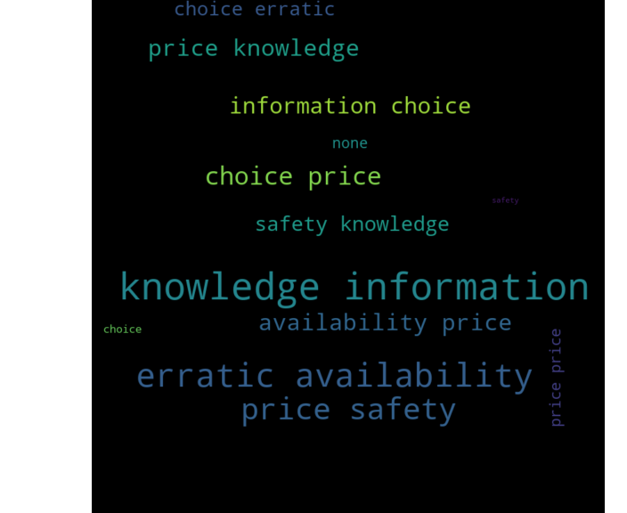
S K I N C A R E P A I N P O I N T S
Some of the main challenges that participants have been facing in regards to skincare are lack of information on skin care, lack of consistently available products and more choices, and lack of affordable products
Uncover has to provide consistent, reliable and effective information.
Products they produce also need to be have more variety, affordable and consistently available in stores that customers can access..

Slide 15
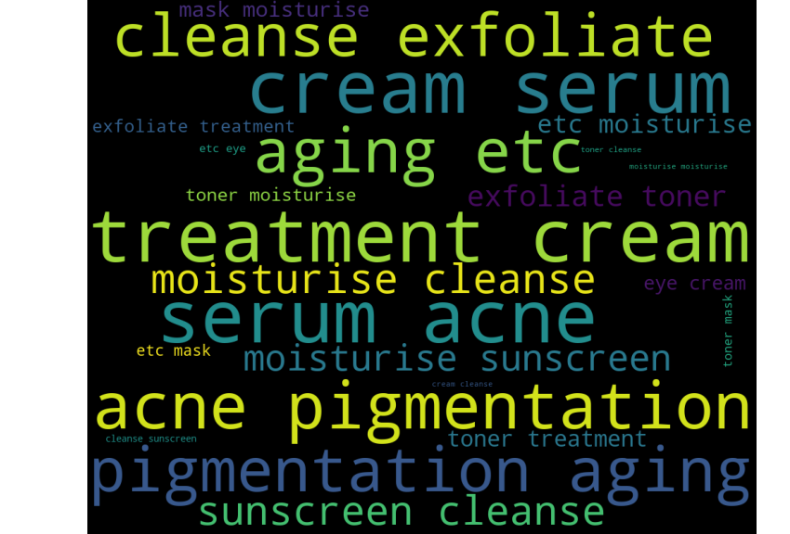
S K I N C A R E R O U T I N E S
The most common skincare routines for the participants include cleansing, exfoliating, treating acne, pigmentation, aging, using serums and moisturizers.
This means that the market is interested in cleansers, exfoliaters, acne treatments, anti-aging products, and serums.

Slide 16
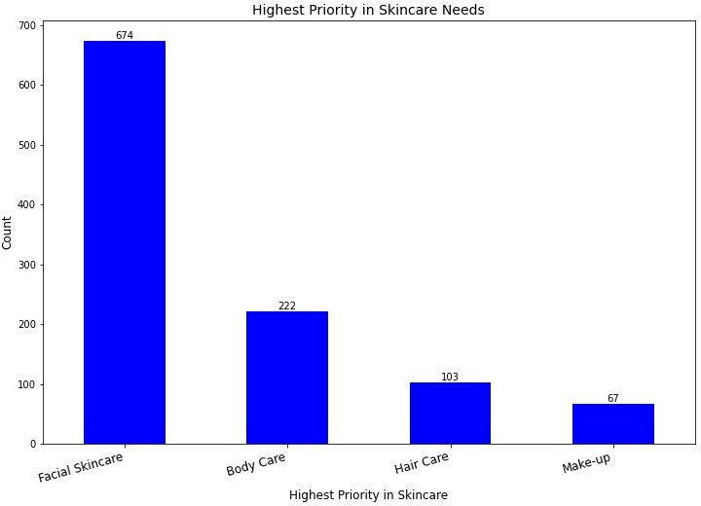
H I G H E S T P R I O R I T Y I N S K I N C A R E
(63.2%)
674 respondents have facial skincare as their first priority. Which means that Uncover needs to mainly focus on producing and distributing facial skincare products.
(20.8%)
(9.7%)
(6.3%)

Slide 17
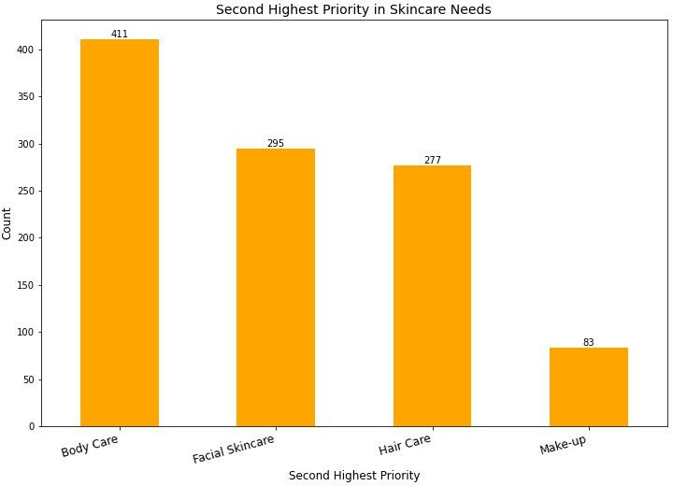
S E C O N D H I G H E S T P R I O R I T Y I N S K I N C A R E
(38.6%)
The second priority is body care.
This gives the insight to Uncover on future products. Once the company has capitalized on facial products,they can produce bodycare products.
(27.7%)
(26.0%)
(7.7%)

Slide 18
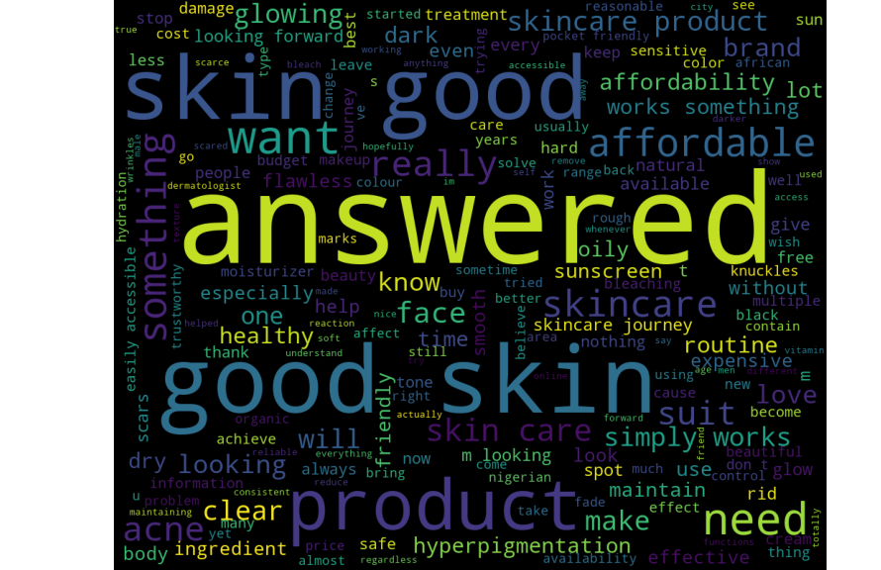
S K I N C A R E E X P E C T A T I O N S
The most common expectations from the participants are good, clean, and glowing skin. Other aspects are affordability, hyperpigmentation, and easily available.

Slide 19
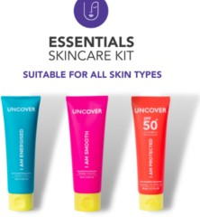
C O N C L U S I O N
The Uncover customer profile can be described as a woman between the ages of 24-35, living in a Nigerian urban city, loves to shop from physical stores, does not necessarily attach themselves to influencers, and is concerned with their acne skin problems and wants to have good skin.
The customer is also concerned with getting the right information on skincare and getting affordable products easily.
Uncover can effectively reach and interact with its customers through social media posts and blogs.
Uncover needs to focus on producing and selling facial skincare products.
There is no preference for particular physical stores what customers care about is access to the products. In this dataset, influencer marketing is not very impactful.
Uncover should focus on facial skincare and can venture into bodycare and haircare in the near future. Bleaching is a unique and important concern that the brand can work to address.

Slide 20
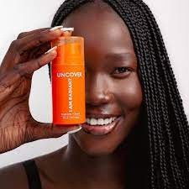
R E C O M M E N D A T I O N S
When it comes to product development, Uncover should focus on producing a variety of products that address acne and hyperpigmentation.
Although the company is now focused on the female market, an expansion into skincare for men and skincare for the older market is something to consider.
Partnering with Laura Ikeji or Iyabo Ojo who are influencers in the age group of 35-44 can expand the brand's market to an older age bracket.
Data should also be collected from the older age groups through alternative platforms that are popular with the relevant agegroup.
Products also need to be priced favorably below 25,000 Naira to attract the larger market.
Distribution needs to be focused in the larger cities and products sold in physical shops.
Uncover does not need to focus on influencer marketing since offline shopping is preferred but can choose to partner with micro-influencers.
Communication with consumers and potential customers should be done through blogs and social media posts.

